Slide 1
Project task..
"Sports Basics" is a sports blog company that entered space recently. They wanted to get more traffic to their website by releasing a special edition magazine on IPL 2024. This magazine aims to provide interesting insights and facts for fans, analysts and teams based on the last 3 years' data.
Python code-data-analysis-project/Cricket data analytics.ipynb at main · chirag2412/data-analysis-project (github.com)
Sql code-data-analysis-project/cricket dataanlysis.sql at main · chirag2412/data-analysis-project (github.com)

Slide 2
Research objective 1.understanding batting performance based on total run socre,strike rate and batting average. 2.understanding bowling performance based on total wicket taken,economy rate and bowling average 3.understanding top team based on winning percentage. 4.understanding top team based on win by chasing target and defending target. Tools being use-:MySql,jupyter notebook for creating graph.

Slide 3
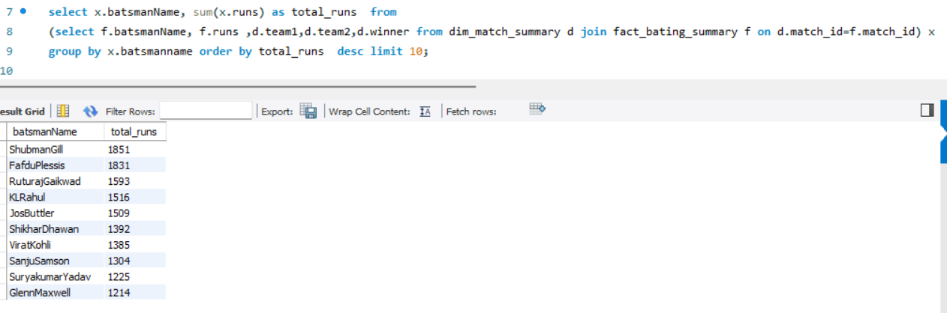
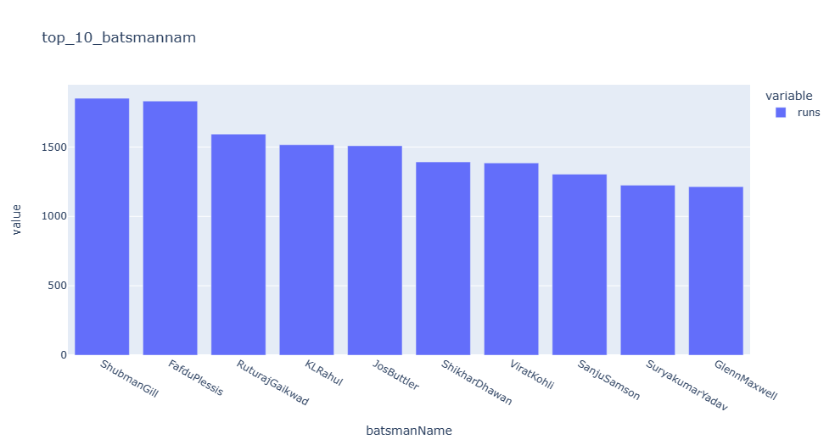
1Top 10 batsmen based on past 3 years total runs scored.

Slide 4
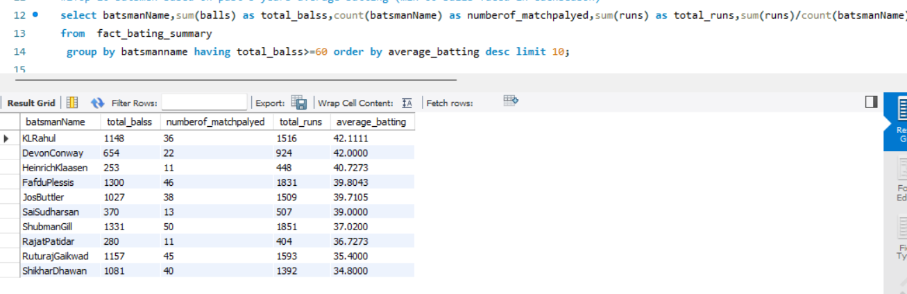
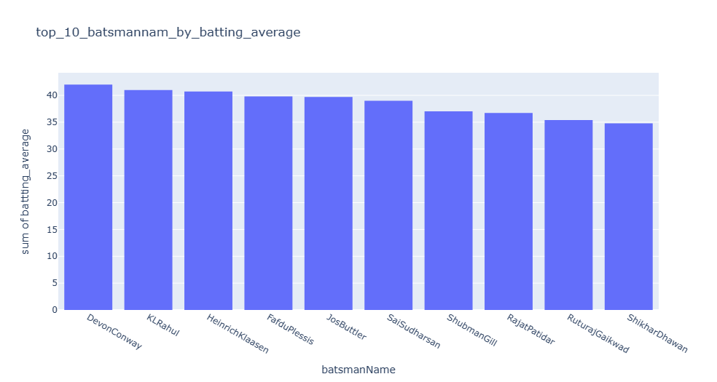
Top 10 batsmen based on past 3 years batting average. (min 60 balls faced in each season)

Slide 5
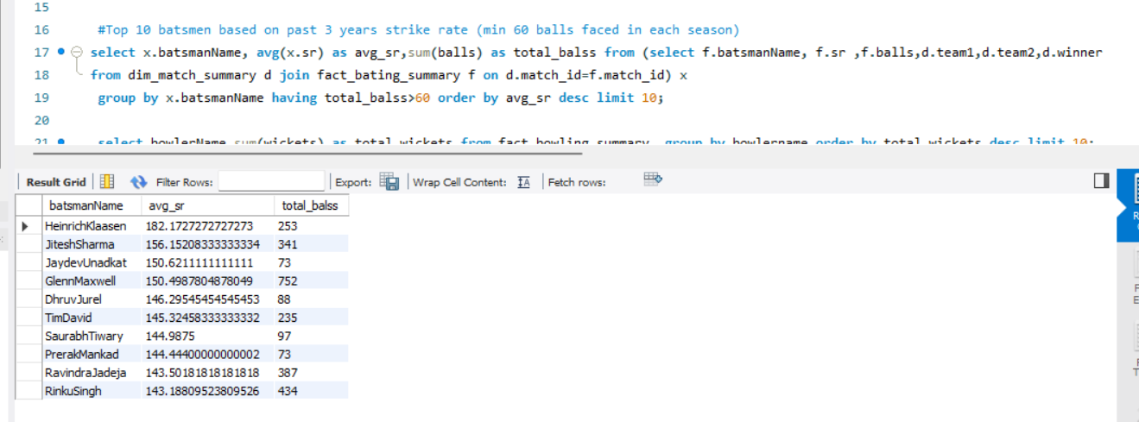
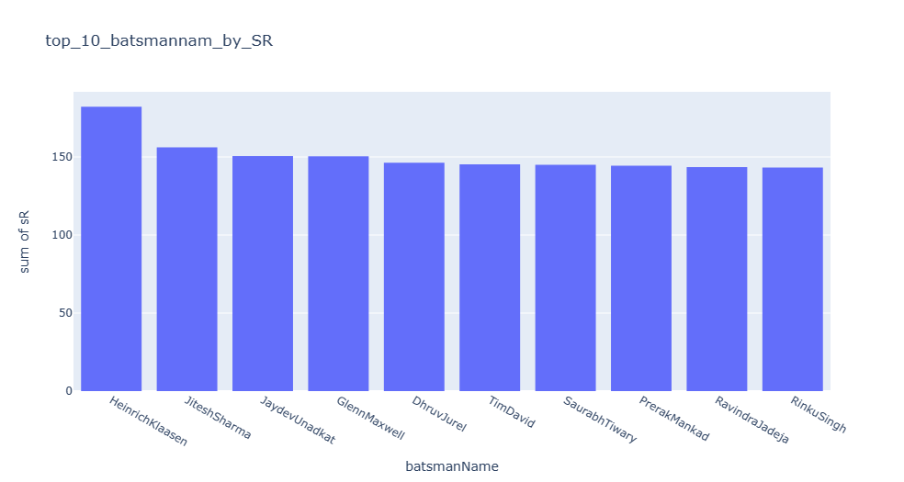
Top 10 batsmen based on past 3 years strike rate (min 60 balls faced in each season)

Slide 6
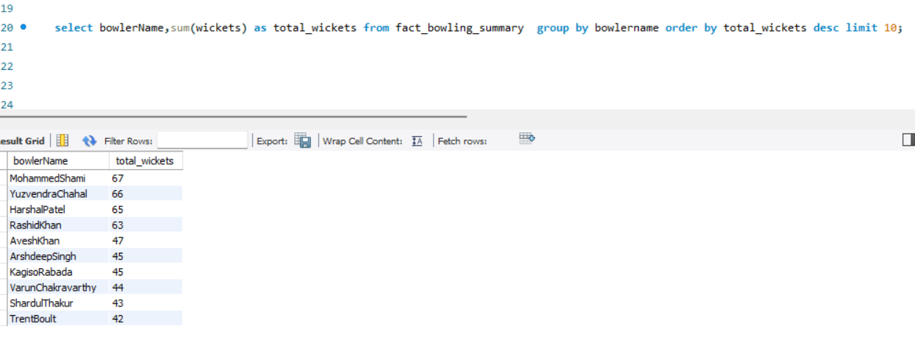
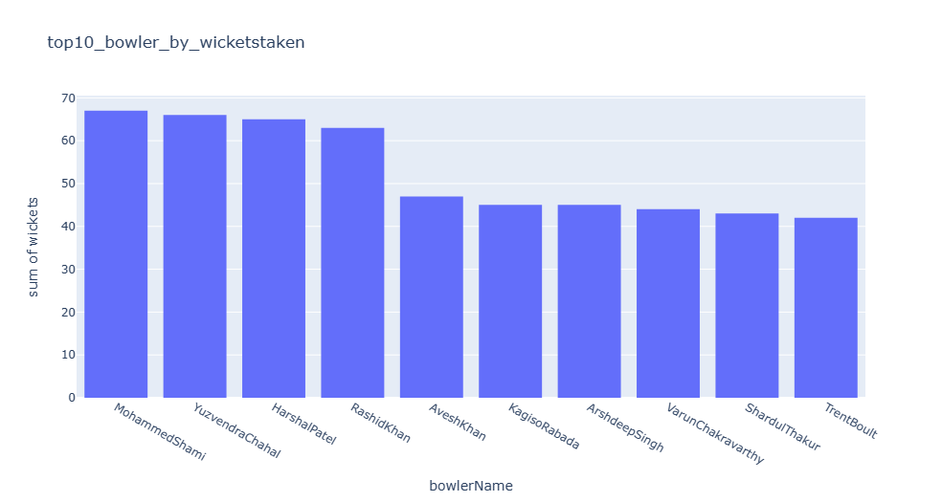
Top 10 bowlers based on past 3 years total wickets taken.

Slide 7
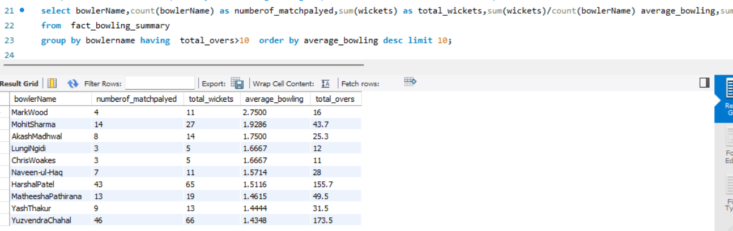
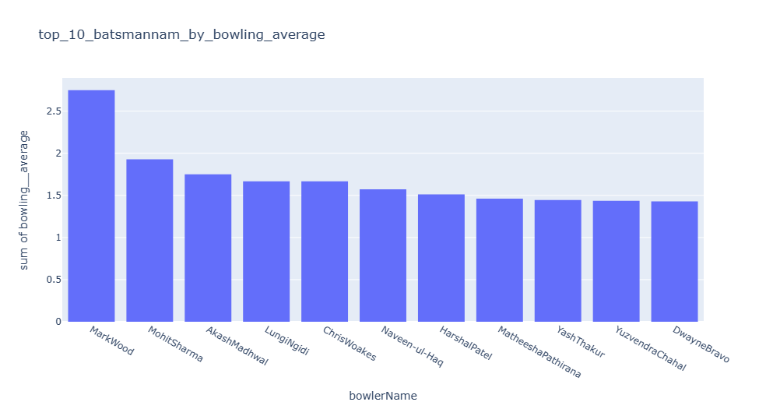
Top 10 bowlers based on past 3 years bowling average. (min 60 balls bowled in each season)

Slide 8
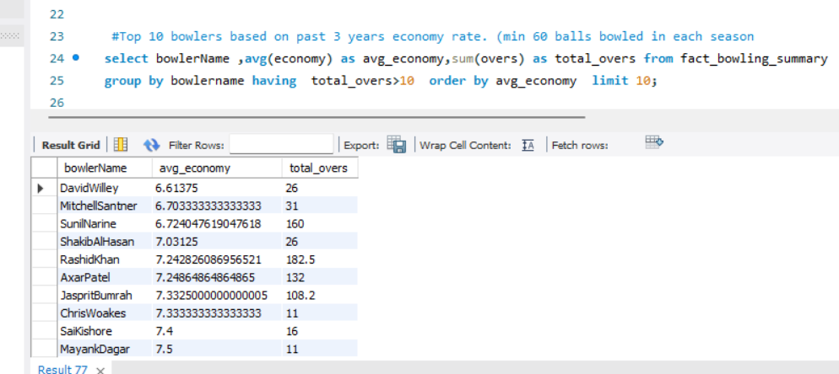
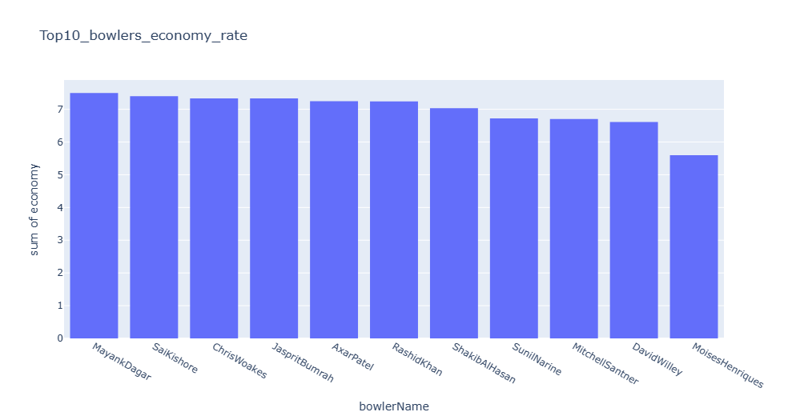
Top 10 bowlers based on past 3 years economy rate. (min 60 balls bowled in each season)

Slide 9
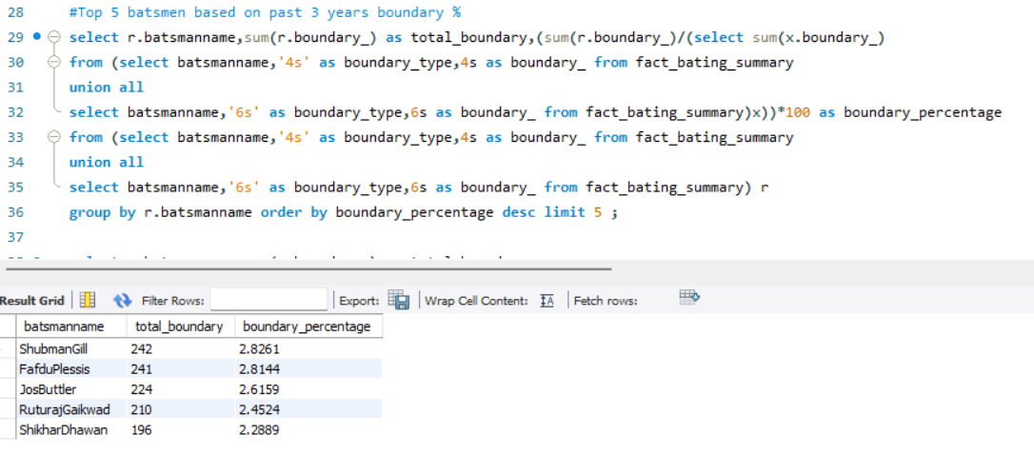
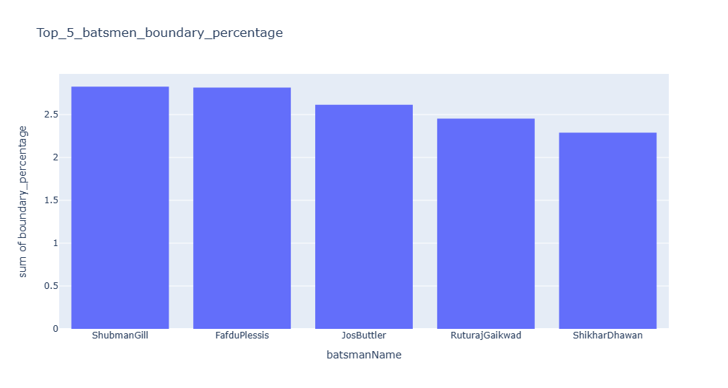
top 5 batsmen based on past 3 years boundary % (fours and sixes).

Slide 10
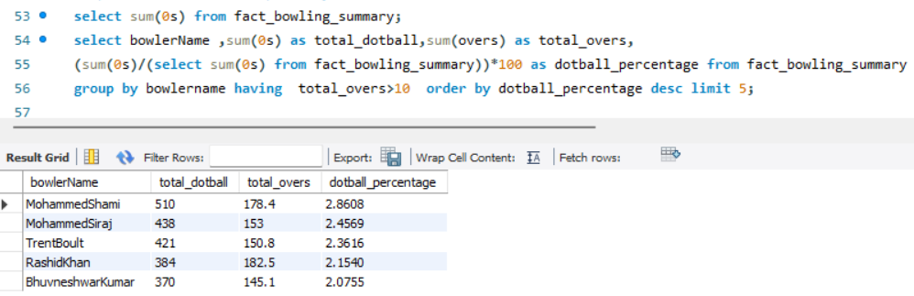
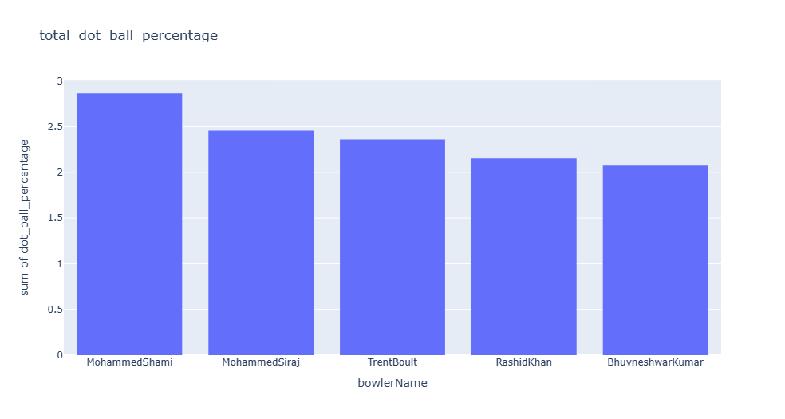
Top 5 bowlers based on past 3 years dot ball %.

Slide 11
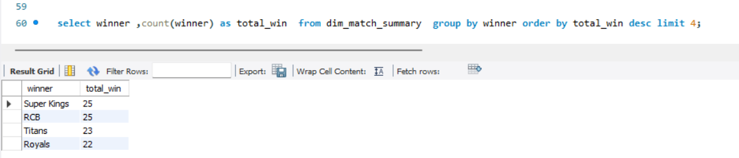
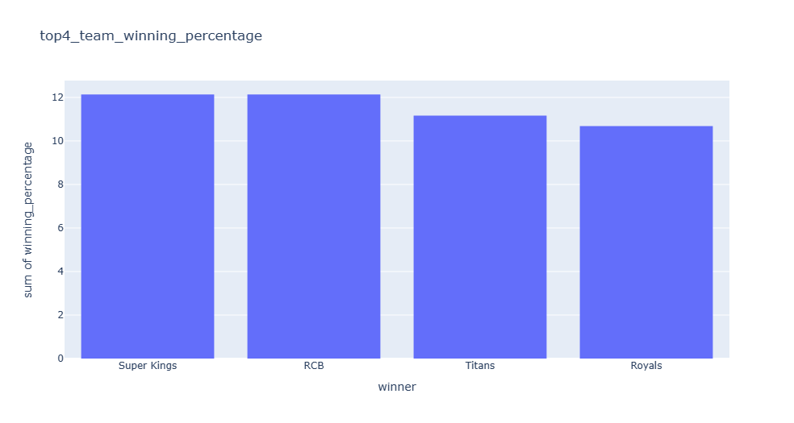
Top 4 teams based on past 3 years winning %

Slide 12
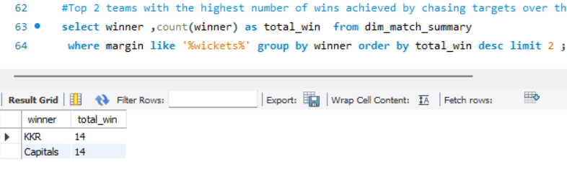
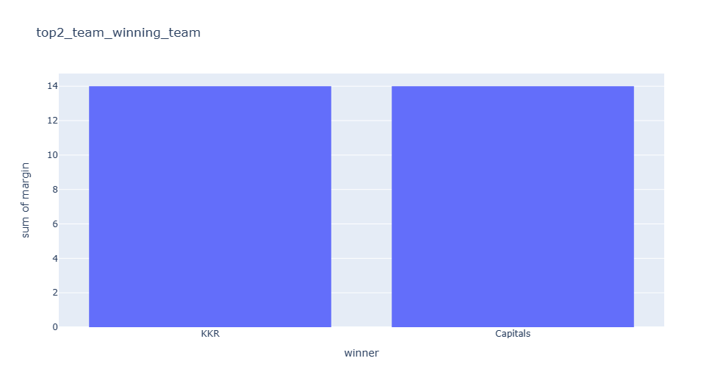
Top 2 teams with the highest number of wins achieved by chasing targets over the past 3 years.

